Slide 1
A Linear Time Algorithm for The Minimum Weighted Feedback Vertex Set on Diamonds
Information Processing Letters 94(2005) 29-35
F. Carrabs , R. Cerulli , M. Gentili, G. Parlato
Presenter: Jun-Shong Lin
Date: March 24, 2006

Slide 2
Abstract
Given an undirected and vertex weighted graph G,
the Weighted Feedback Vertex Problem (WFVP)
consists in finding a subset F ⊆V of vertices of
minimum weight such that each cycle in G contains
at least one vertex in F. The WFVP on general
graphs is known to be NP-hard. In this paper we
introduce a new class of graphs, namely the
diamond graphs, and give a linear time algorithm to
solve WFVP on it.

Slide 3
Introduction
An undirected graph G = (V ,E), a Feedback Vertex Set (FVS) of G is a subset F ⊆V of vertices such that each cycle in G contains at least one vertex in F.

Slide 4
Introduction
The Weighted Feedback Vertex Problem (WFVP) on a weighted graph G consists in finding an FVS of minimum weight.
w(v)
V

Slide 5
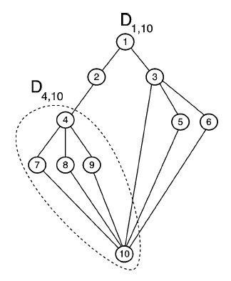
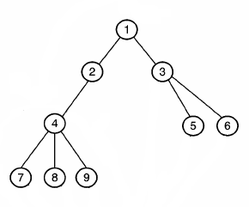
The class of diamond graphs
G = (V,E,w) be an undirected and vertex weighted graph.
C1 = {2 , 3}
C4 = {7 , 8 , 9}
T

Slide 6
The class of diamond graphs
h(u) = 0 ,if u is a leaf.
h(u)=max_{x∈Cu}{h(x)}+1,
otherwise.

Slide 7
The class of diamond graphs
Definition 1.
(i) each v ∈ V is included in at least one simple path between r and z .
(ii) Dr, z \ {z} is a tree.

Slide 8
The class of diamond graphs
EXAMPLE:
D1,10 = D2,10 + D3,10
h(T4) = h(4) = 1

Slide 9

The dynamic programming algorithm
Observation 1.
An optimum solution F* of WFVP on Dr.
1. {z}.
2. ⊆ V \ {z} be an FVS on Dr,
W( ) ≦ w(z).

Slide 10
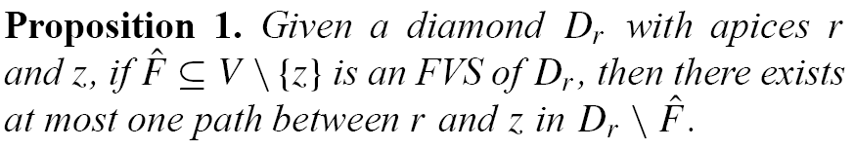
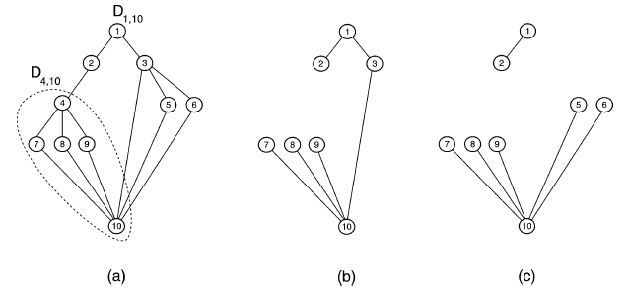
The dynamic programming algorithm

Slide 11
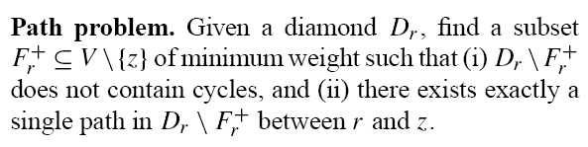
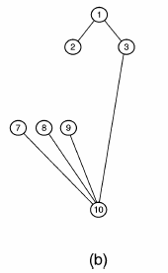
The dynamic programming algorithm

Slide 12
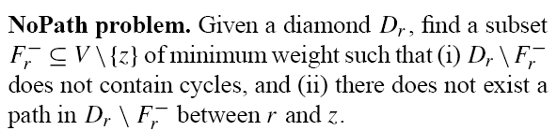
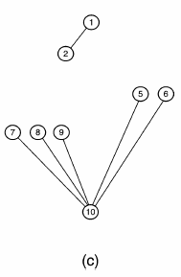
The dynamic programming algorithm

Slide 13
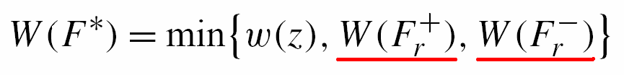
The dynamic programming algorithm
The optimum solution F* of WFVP
on Dr :

Slide 14
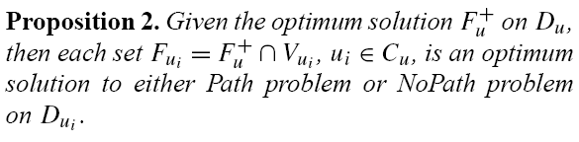
The dynamic programming algorithm

Slide 15
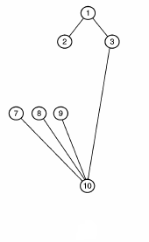
The dynamic programming algorithm
Proposition2.
EXAMPLE:
Optimum solution:
F1⁺ = { 4, 5, 6 }
F2 = F2⁻ = { 4 }
If there is a set F2’⁻ = { 8, 9 },then W(F2’⁻ )<W(F2⁻).
F1’⁺ = (F1⁺ \ F2) ∪ F2’⁻ = { 5, 6, 8, 9 },and W(F1’⁺ )<W(F1⁺).
Contradiction!

Slide 16
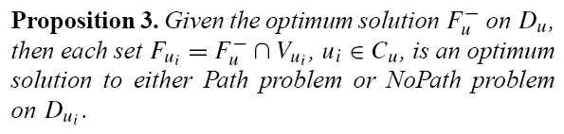
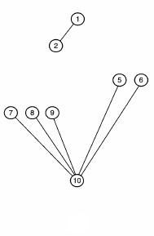
The dynamic programming algorithm

Slide 17
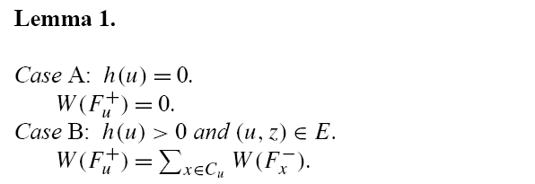

The dynamic programming algorithm
u
u
…..
….
Fx⁻
.
.
.
Fx⁻
Fy⁻
.
.
Fy⁻
Fx⁺
…..
…..
z
z

Slide 18
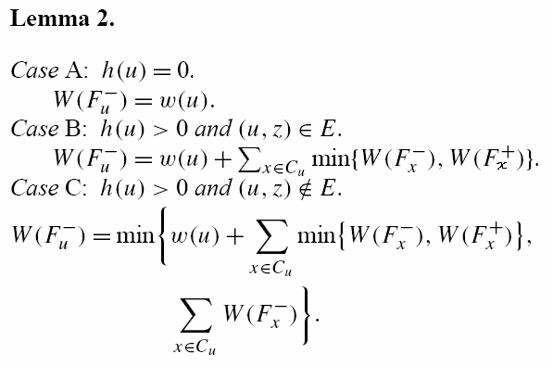
The dynamic programming algorithm
u
…..
Fx⁻
or
Fx⁺
…..
z
u
….
Fx-
.
.
Fx-
or Case B
…..
z

Slide 19
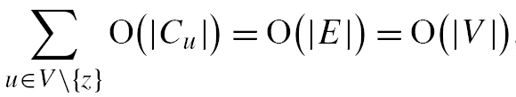
The computational complexity of the algorithm
Lemma 1:
Case A: O(1)
Case B: O(|Cu|)
Case C: O(|Cu|)
Lemma 2:
Case A: O(1)
Case B: O(|Cu| + 1) = O(|Cu|)
Case C: O(|Cu|)
The computational complexity of the algorithm
is given by
(|E| ≦ 2|V|)

Slide 20
The computational complexity of the algorithm
Iu = TRUE if and only if u∈Fu⁻.
Given x∈Cu, Px⁺=+(Px⁻=+)if Fx⁺⊆Fu⁺
(Fx⁺⊆Fu⁻) and Px⁺=-(Px⁻=-) if Fx⁻⊆Fu⁺
(Fx⁻⊆Fu⁻)

Slide 21
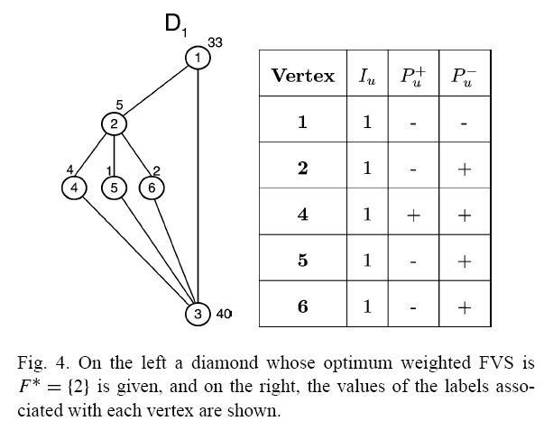
The computational complexity of the algorithm
EXAMPLE:
F1⁺ = { 2 } , F1⁻ = { 1, 5, 6 }
F2⁺ = { 5, 6 }
F4⁺ = ψ => P4⁺ = +
(F4⁺⊆F2⁺)
F5⁻ ={5} => P5⁺ = -
(F5⁻⊆F2⁺)
F6⁻ = {6} => P6⁺ = -
(F5⁻⊆F2⁺)

Slide 22
Conclusion
The weighted feedback vertex set problem on diamonds can be solved in
O(|V|) time.

